Slide 1

Airline Management System
Database Systems
End Semester Project
BSCS-11-C
Group Members:
Mahad Mohtashim – 379889
Mehar AliAhmed – 366651
Muhammad Hamza Aamir - 382725

Slide 2

Introduction to the Idea:
Air travel is the most popular transport system around the globe, yet the complexities attached with it amplify with an increasing demand.
Recent studies show that every second about 270 flights take off and make landing.
Hence an updated system is the need of today therefore we have worked on an improvised and a robust flight database model.
It allows to effectively implement the functionalities coupled with it.
Database system operations can be easily employed to handle the huge amount of data ranging from passenger details to flight details in the field of flight handling.
The idea is to manage all the data related to airline companies in an efficient way to make management easy.
Flight Tracking
Passenger Biodata
Air traffic Information
Luggage Tracking
Airports
Airplane Details
Country
Pilots Information | Luggage Team
Crew Members Information | Road Transport | Planes Tracking and map
Ground Staff Details | Health Support | Research Teams
Billing Details | Administrative | Ticketing Apps
Central Modules | Back End Working and Support System

Slide 3
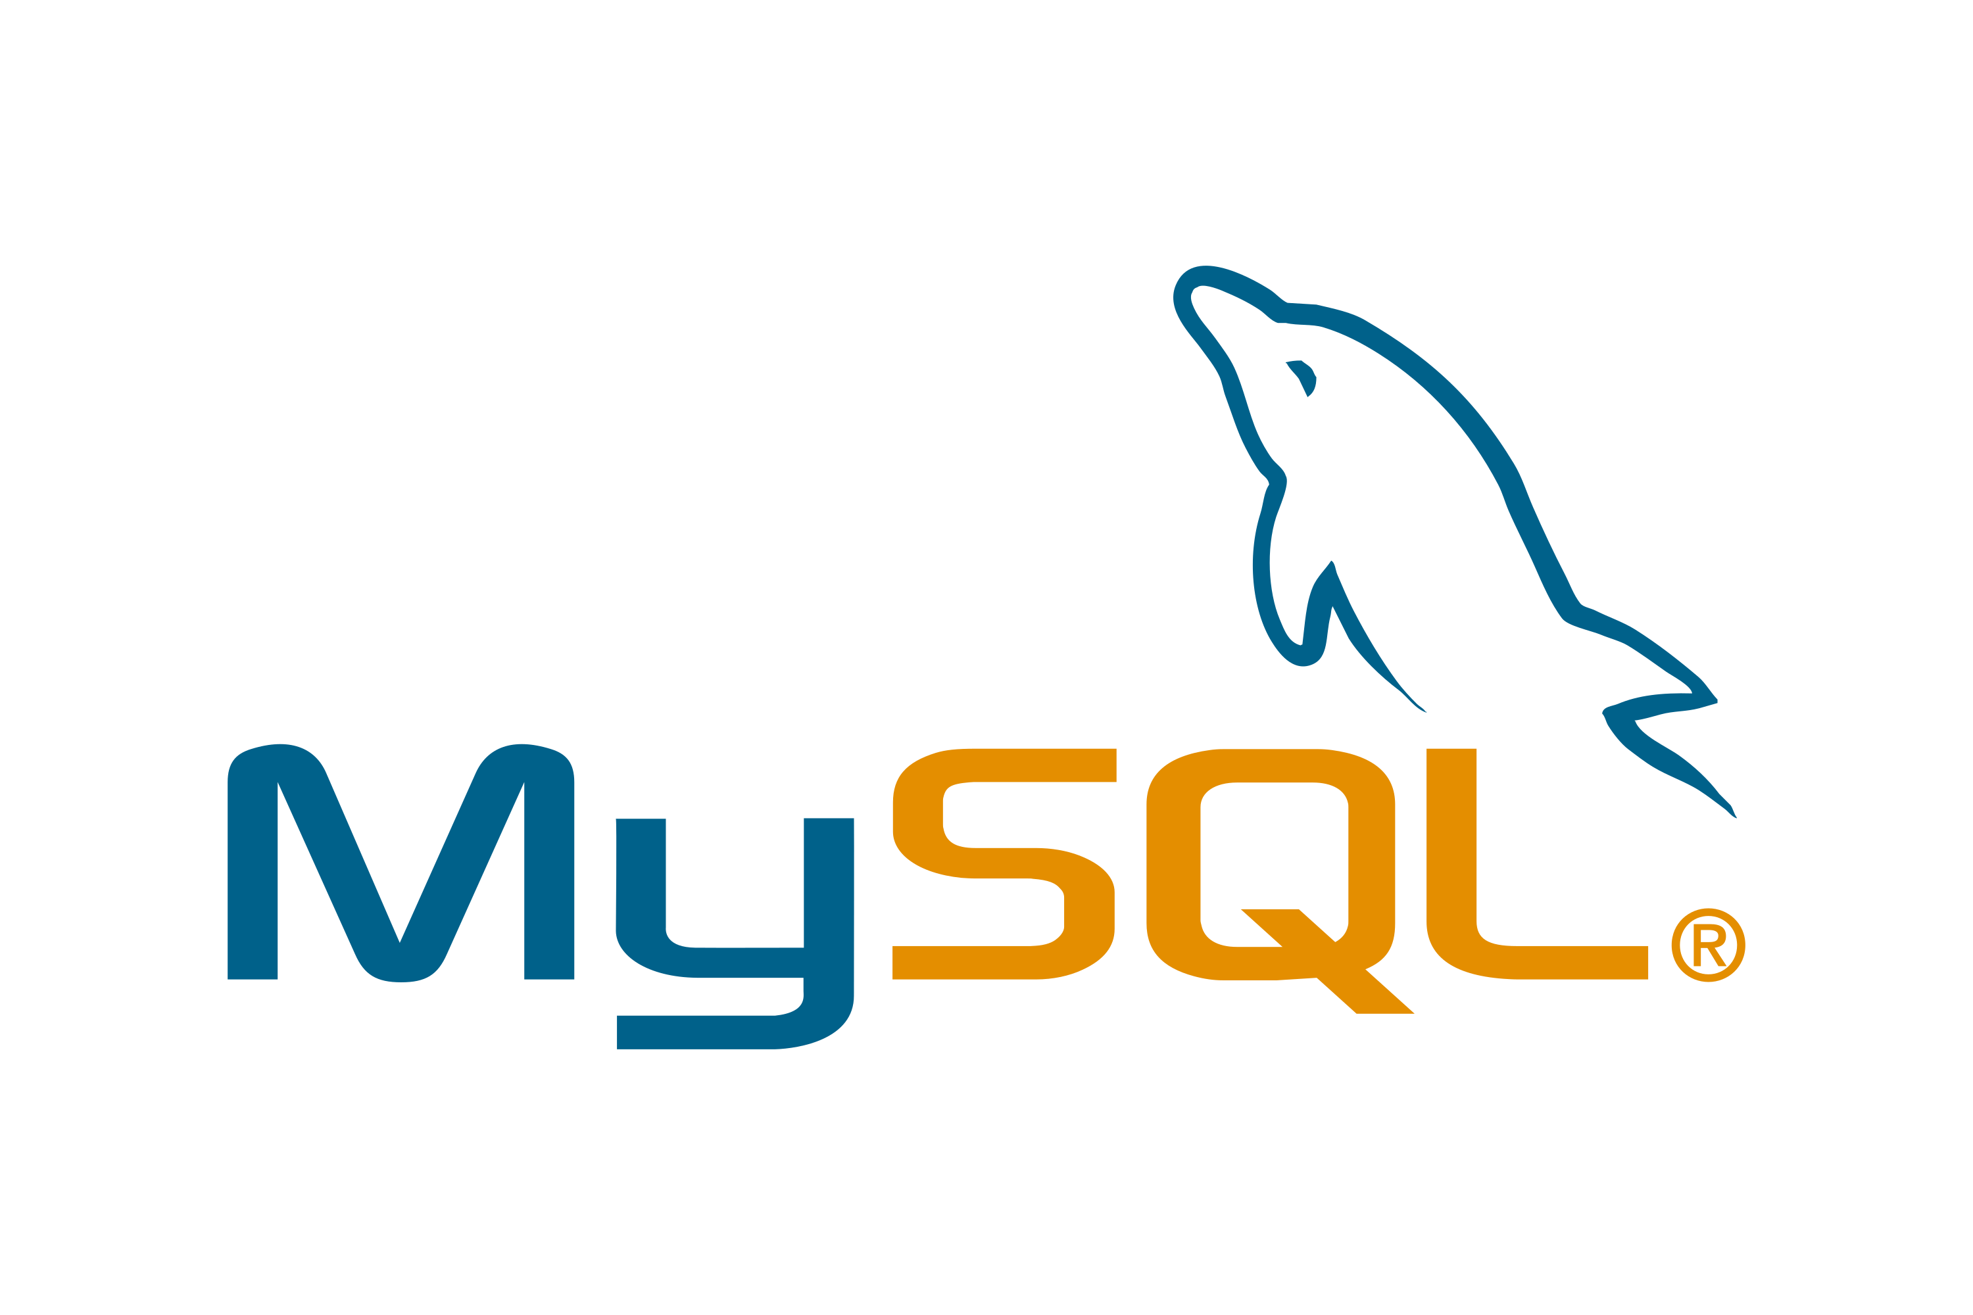

Tools used for implementation
Our project is a desktop-based application which implements the MVC architecture in the following way:
Model: We have used MySQL RDBMS to create the data layer of the project. Variety of data related to the aviation management system has been stored in more than 20 relations each defining a unique aspect.
View: PyQt5 library is used to create a User Interactive GUI Application which links all the dataset to the application layer through various functions that come along with it.
Controller: Python along with it’s libraries such as MySQL. Connecter has been used to connect the data layer with the application layer to implement logic which processes the data.

Slide 4

Functionalities of the Product:
Functionalities included in the project are the mentioned below however not limited to:
Allows the admin user only to manage updation, deletion, and insertion into the database. This way we implement authorization and authentication for the security of project.
Main areas of the database i.e., passenger details, flight details, aircraft details and airport details form the main pillars of the project and are linked to each other through the execution of different queries working to ensure strong connectivity between each of these entities.
While we cover maximum fields of this database systems, yet there is still a plethora of different activities that can be implemented as the structural design is easy to understand.
In addition, we have linked the QtWidgets functionalities with each query that is being executed in the RDBMS.
Explained more in the ERD in the next slide.

Slide 5
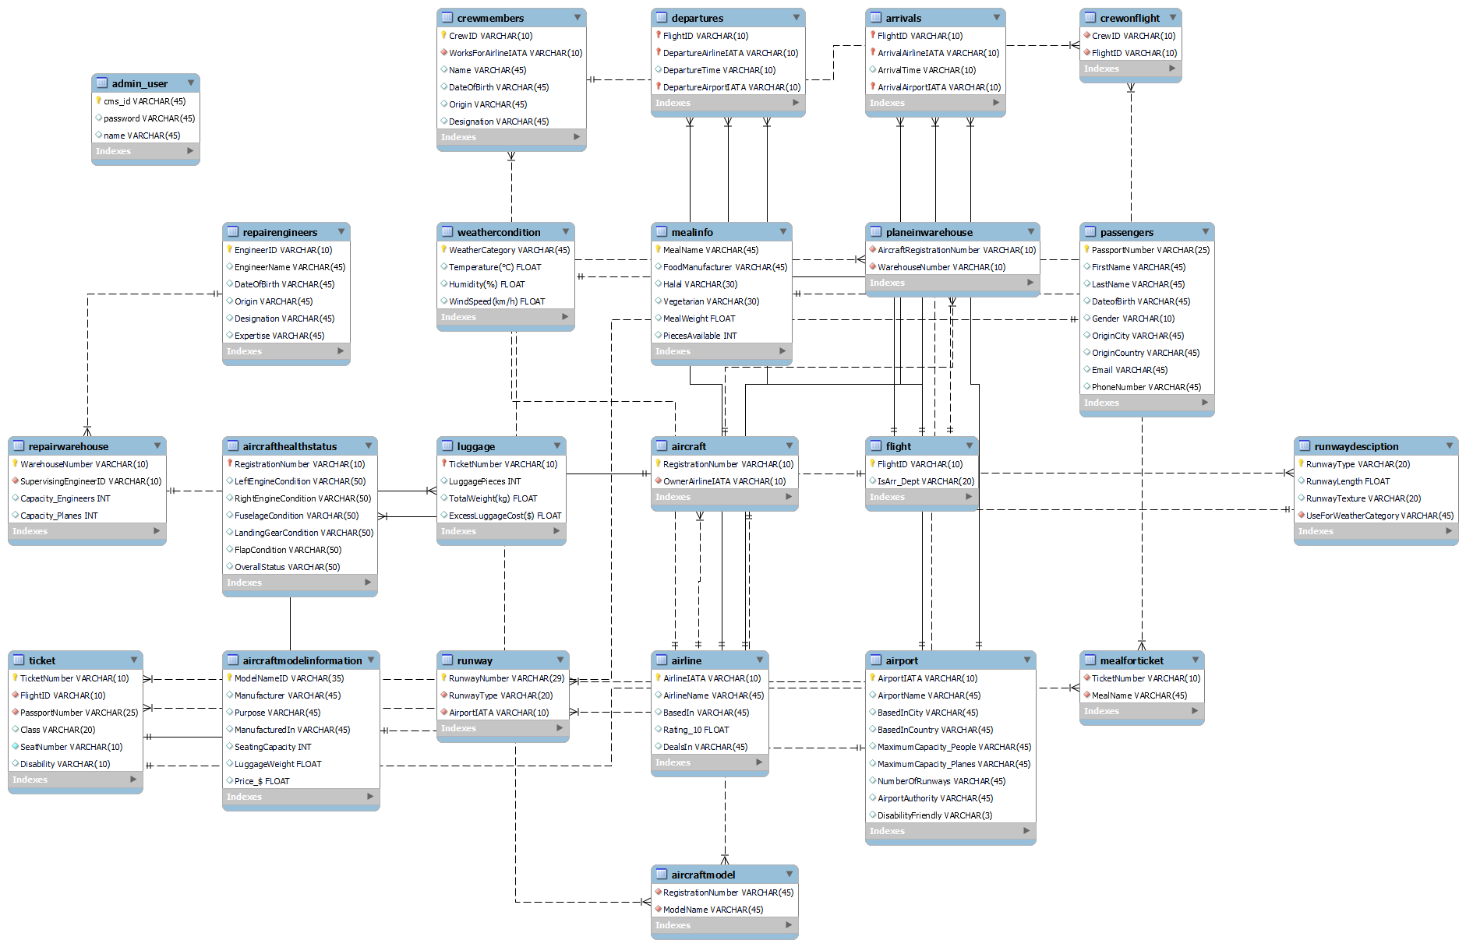
ERD of the Database:

Slide 6
Overview of the GUI
Login Window
Authorizes the admin of the user and moves to the next Main Menu window, if not it asks for correct details. However, a unique feature is the fact that Guest can also Login but only view the non private data
Main Menu
Gives option to choose what details the admin wants to see.
Passenger Details
View passenger’s personal information and generate a PDF file of the ticket. Also, it allows to view Passenger Luggage Details
Moreover, admin has the authority to update, insert and delete new passenger details
Flight Details:
Table view of the passenger, meal and crew member information are displayed on this window for a specific flight ID.
Aircraft Details
Sub aircraft entities like model details, health status and repair warehouse information is displayed through the functionality of pressing a function.
Menu bar:
Navigates the user to other windows, logout and access tools defined in the specified window
Airport Details
The airport authority who have bought the software have their details and patent shown on this window.

Slide 7
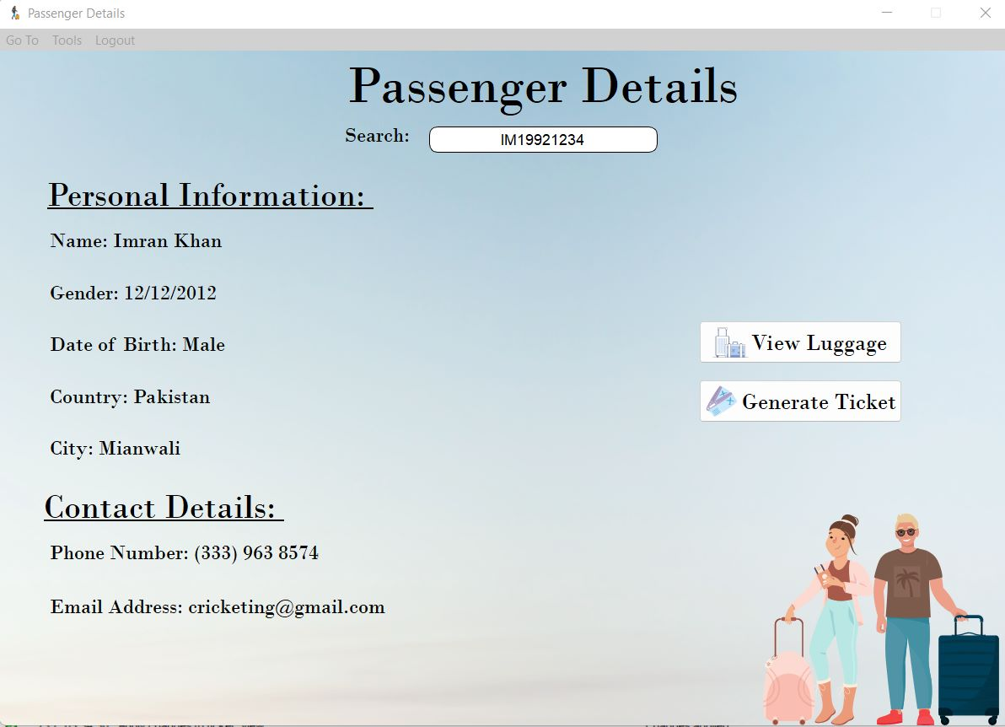
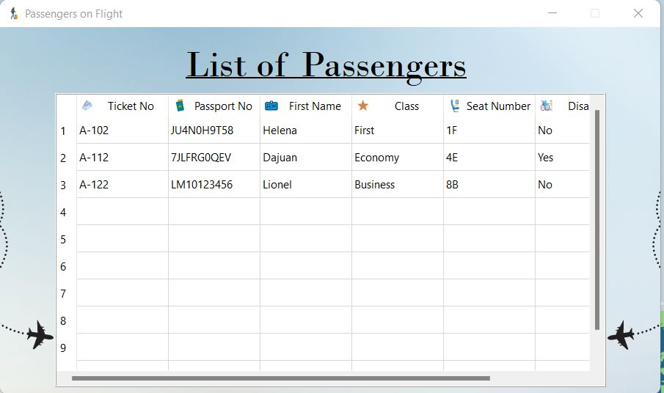
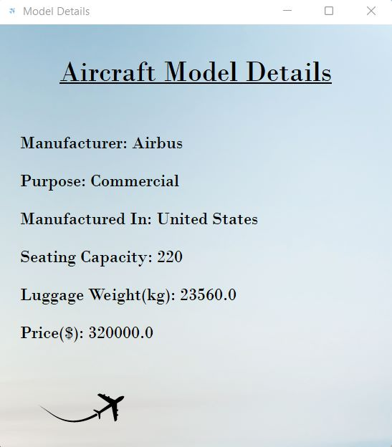
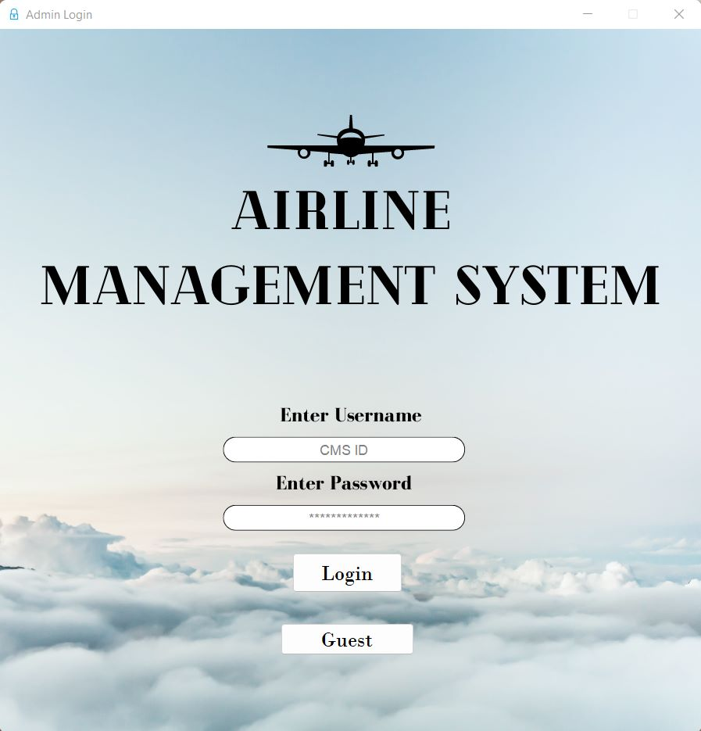
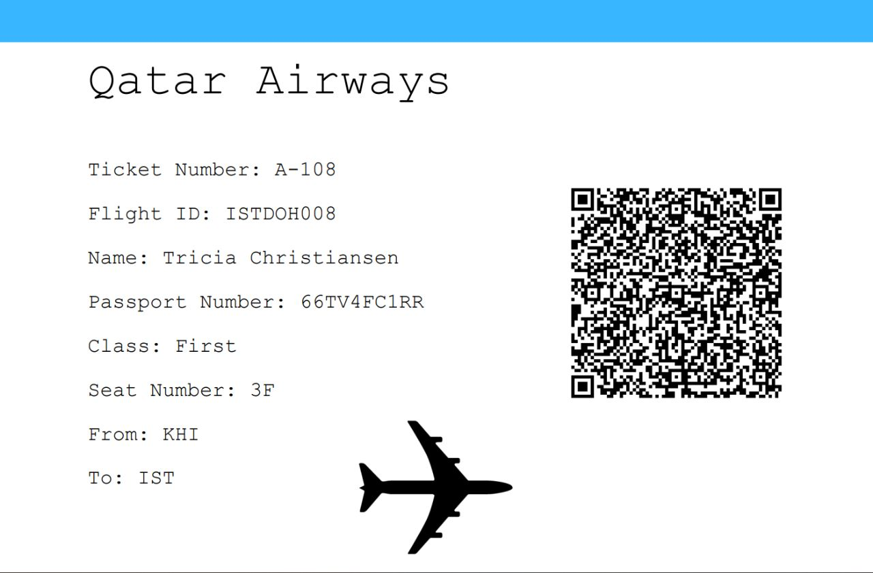
Snippets of the GUI:

Slide 8
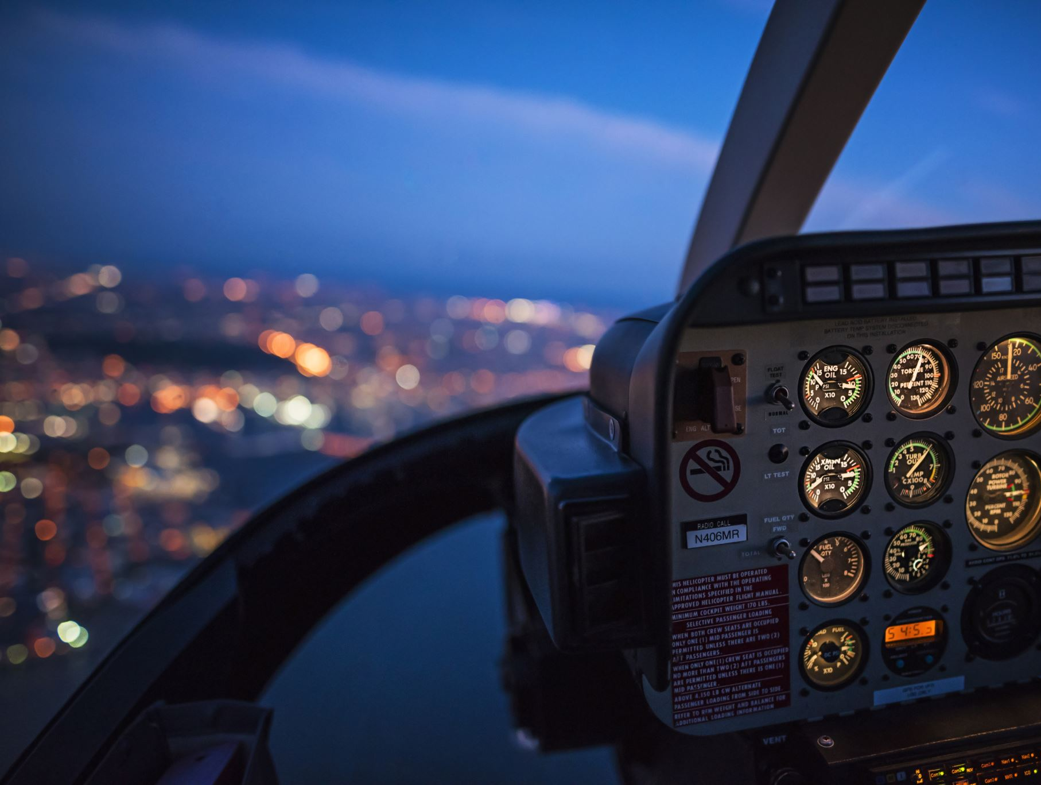
Views, Triggers and Stored Procedures
Views:
Views have been used in the project to carry out the data showing part of the project. The database consists of views related to showing passenger details, aircraft details and flight details which are stored in the views.
Triggers:
Three different triggers have been defined which are linked with one table that records the history of modifications in the database such that the timestamp and the modification status are inserted into that table.
Stored Procedures:
Stored procedures have been created for every query that is running in the backend of the application to connect with the database.

Slide 9

Demonstration

Slide 10

Thank You !
Have a safe journey!

